Slide 1
Routine SA processing with JD+
ESTP Training

Slide 2
In-house developments
DB
Retrieve data/models from user environment
Create ts, spec
JD+ core libraries
Call JD+ routines
Retrieve results
Store data/models in user environment

Slide 3
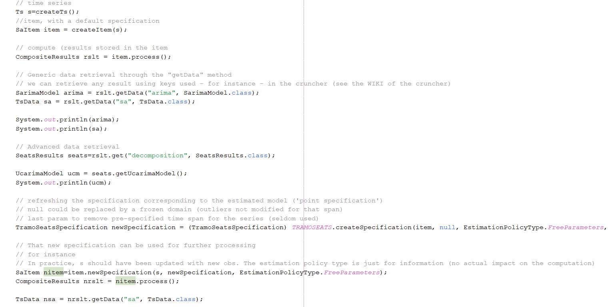
Java code

Slide 4
JD+ solution. Principles
Domain specification
Define the initial(or domain) specification
The estimation gives the point specification (=the result)
Refreshing the model « relaxes » some constraints; the new specification (=estimation specification) is always inside the domain specification
Tip: keep the initial specification as large as possible
Estimate
Point specification
Estimation specification
Refresh

Slide 5
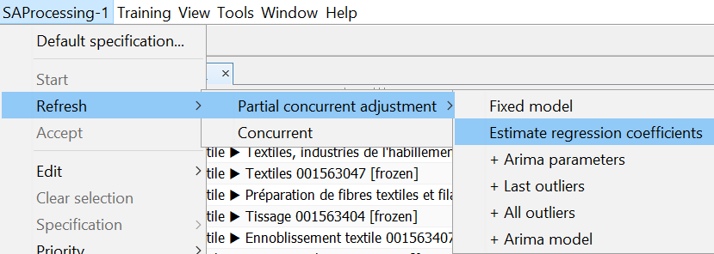
Updating policies
Policy | Re-estimation (cumulative)
Fixed model (partial concurrent) | Nothing
Regression coefficients (partial concurrent) | Regression coefficients
Parameters (partial concurrent) | Coefficients of the ARIMA model
Last outliers (partial concurrent) | Outliers of the last year
Outliers (partial concurrent) | All outliers
Arima (partial concurrent) | ARIMA orders
Concurrent | Log/level + calendar effects

Slide 6
JD+ GUI (I)
Suitable for sets < 3000 series
Steps
Initialization
Define the default specification (or use an existing one)
Modify some specifications (keep them « large »)
Generate and export the results
Save the processing

Slide 7
JD+ GUI (II)
Next estimations
Re-load the workspace
Refresh the processing (for instance)
For normal re-estimation, refresh only the parameters
Refresh the model once each year (or each two years)
Inspect the results and modify them if need be (will modify some « domain specifications »
Exports the results and save the workspace.

Slide 8
JWSACruncher (I)
Suitable for any number of series (split the workspace is several SAProcessing) if need be
Steps
Initialization:
generate the input file (=workspace), using the GUI (don’t process the multi-processing) or using in-house programs

Slide 9
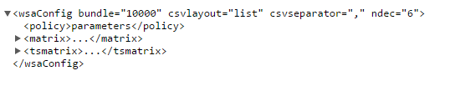
JWSACruncher (II)
Define the setting file for the cruncher
Output, format, paths…
Call the command line
Next estimations
Modify the setting file (if need be)
Re-call the command line

Slide 10
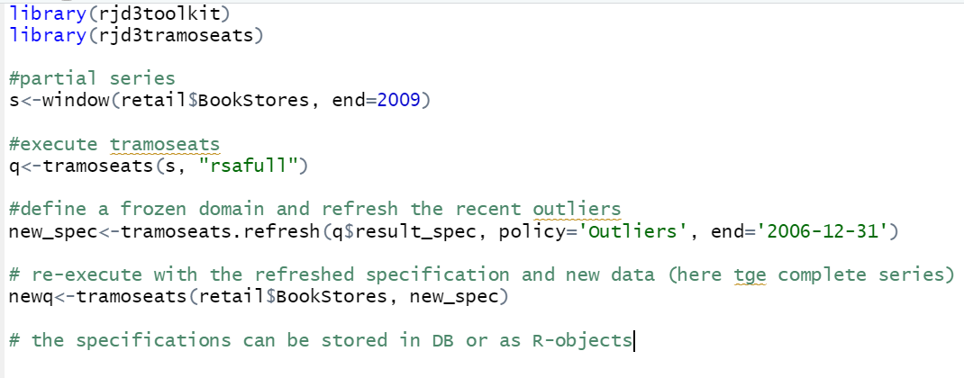
RJDemetra3

